Slide 1
EMed Blockchain
Chain of future

Slide 2
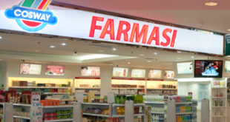

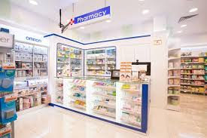
BlockChain Mechanism
Provides order
Places order

Slide 3

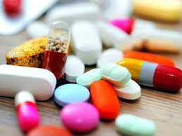
How page works?
Orders meds, which computes a final total
Pharmacist Creates account
Medical retailer’s details
provided

Slide 4
All the details stored under a
New chain connected to distributed nodes

Slide 5
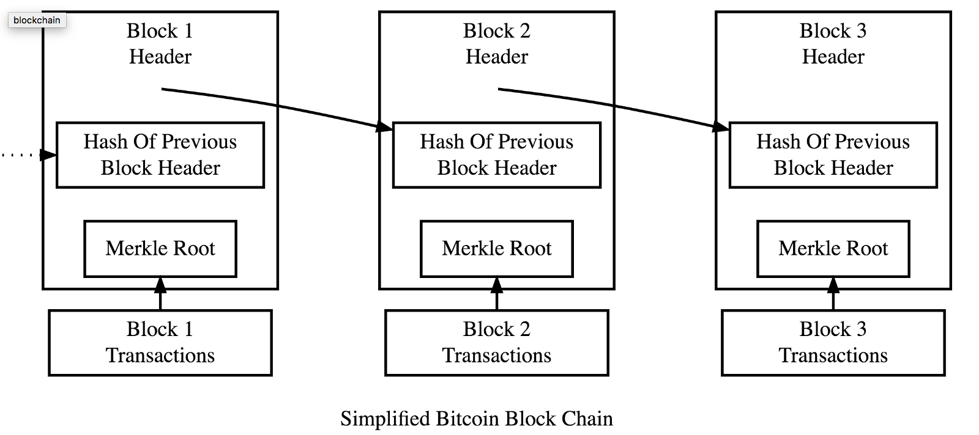
Chain work

Slide 6
Backend feature
Distributed database
Create as many blocks needed
Every block has unique timestamp
Hashing is always linked to previous hash
Any interruption in chain leads to failure .

Slide 7
Frontend Feature*
Create accounts for retailers and pharmacist
Buyers place their order and sellers approves it
Login feature
Creates blocks for every new transaction
Tracking of order in transit
Common pricing system

Slide 8
Thank you

